Slide 1


Slide 2


Slide 3
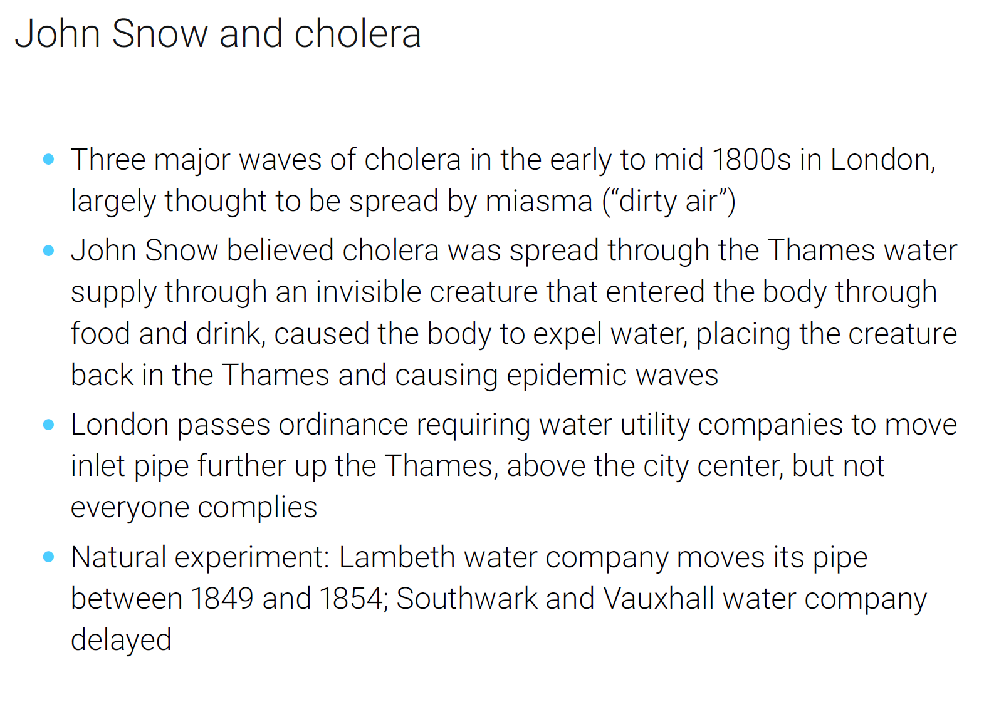
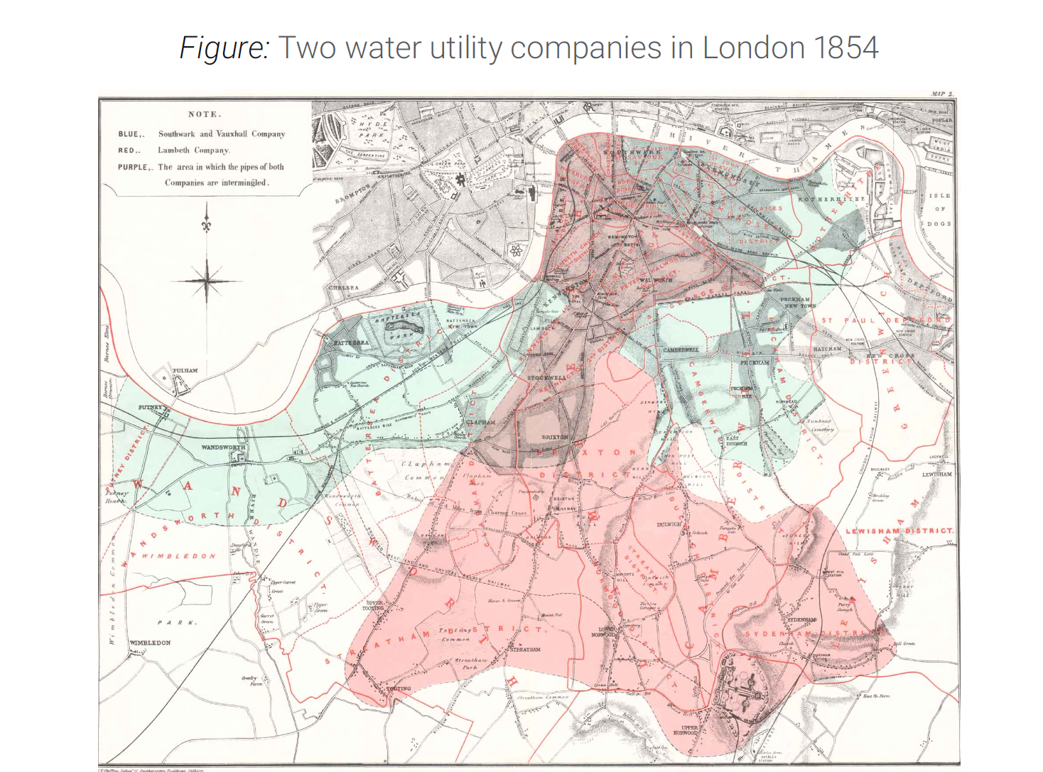
Notes:
Three major waves of cholera in the early to mid 1800s in London,
largely thought to be spread by miasma ("dirty air")
John Snow believed cholera was spread through the Thames water
supply through an invisible creature that entered the body through
food and drink, caused the body to expel water, placing the creature
back in the Thames and causing epidemic waves
London passes ordinance requiring water utility companies to move
inlet pipe further up the Thames, above the city center, but not
everyone complies
Natural experiment: Lambeth water company moves its pipe
between 1849 and 1854; Southwark and Vauxhall water company
delayed

Slide 4
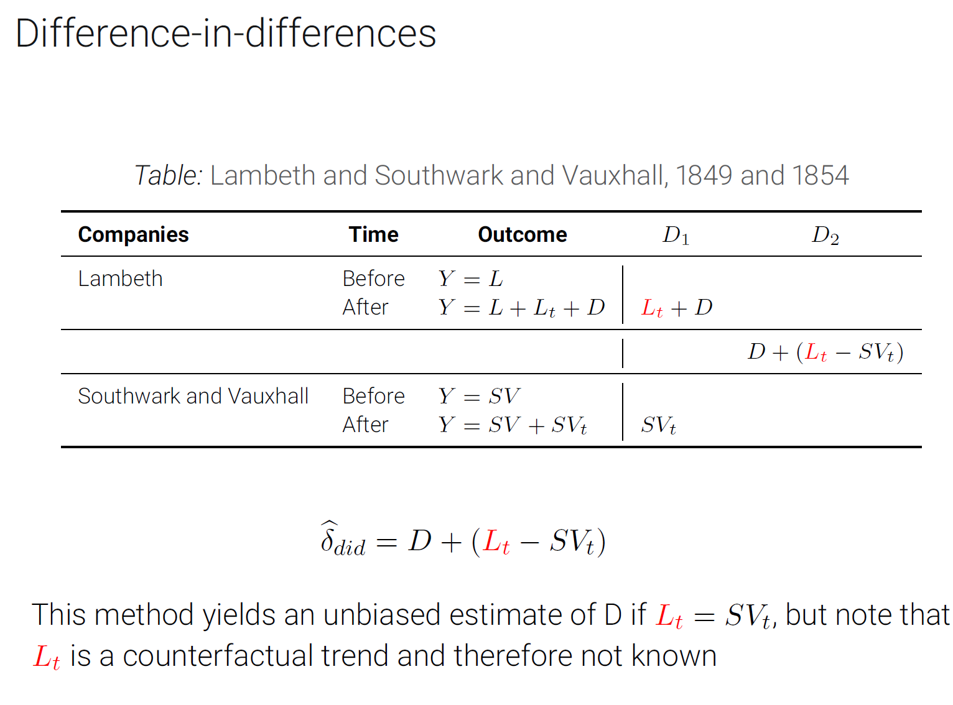

Slide 5
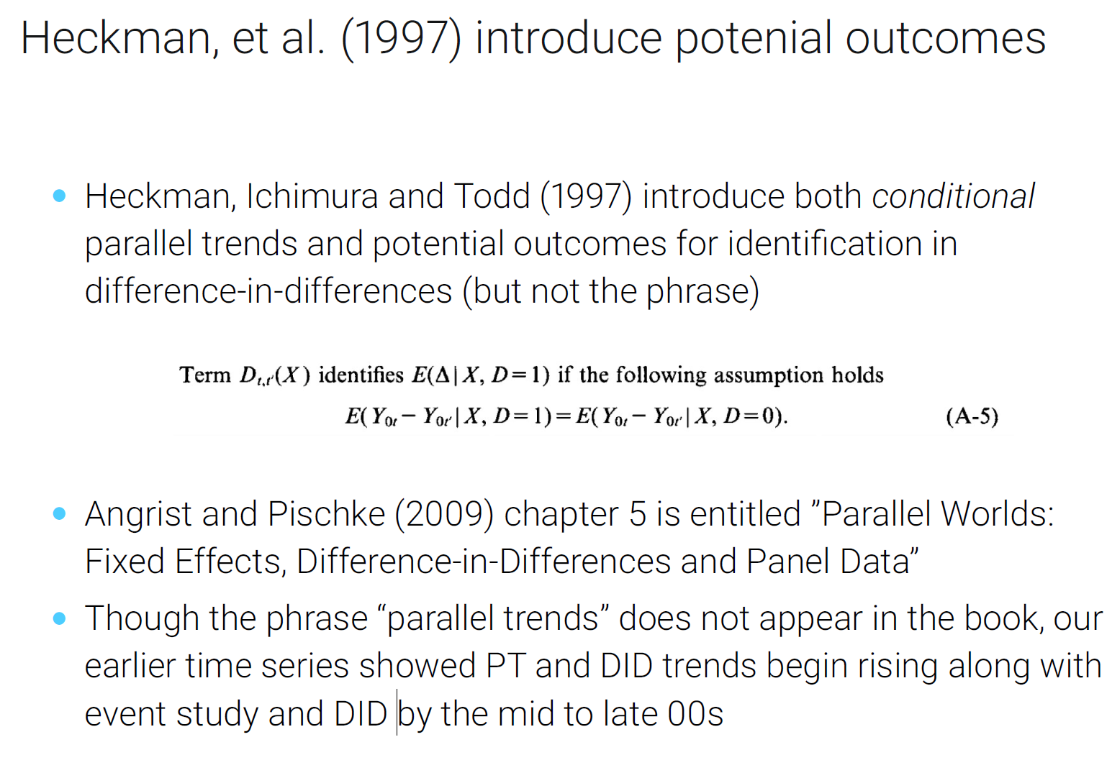

Slide 6
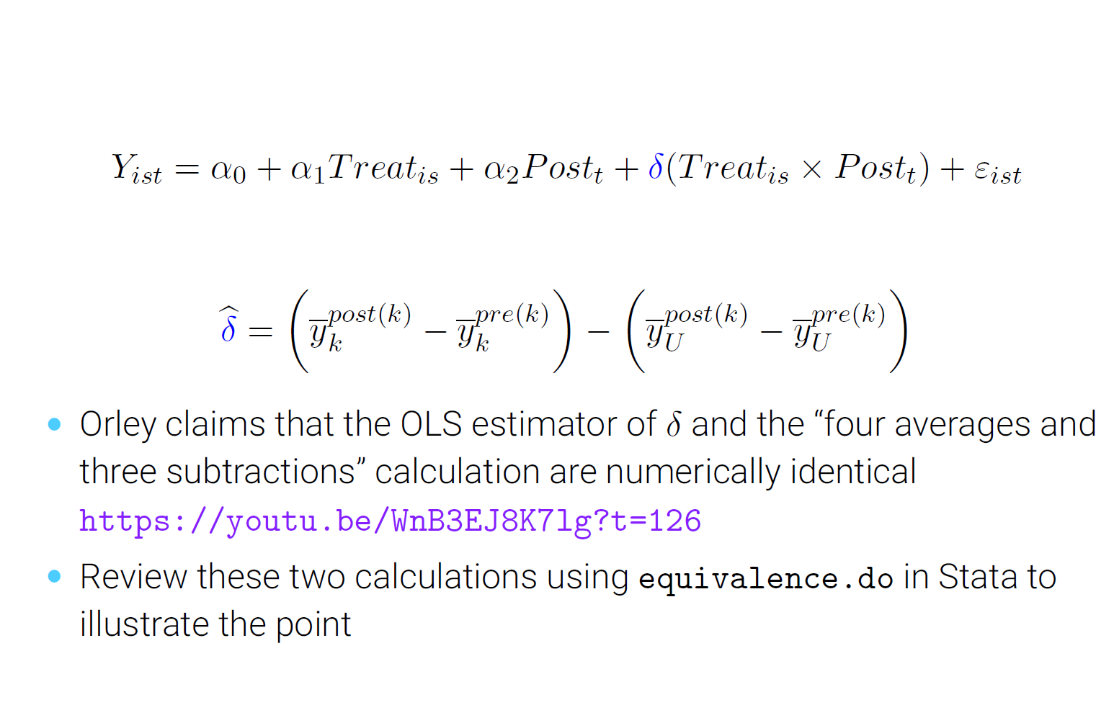
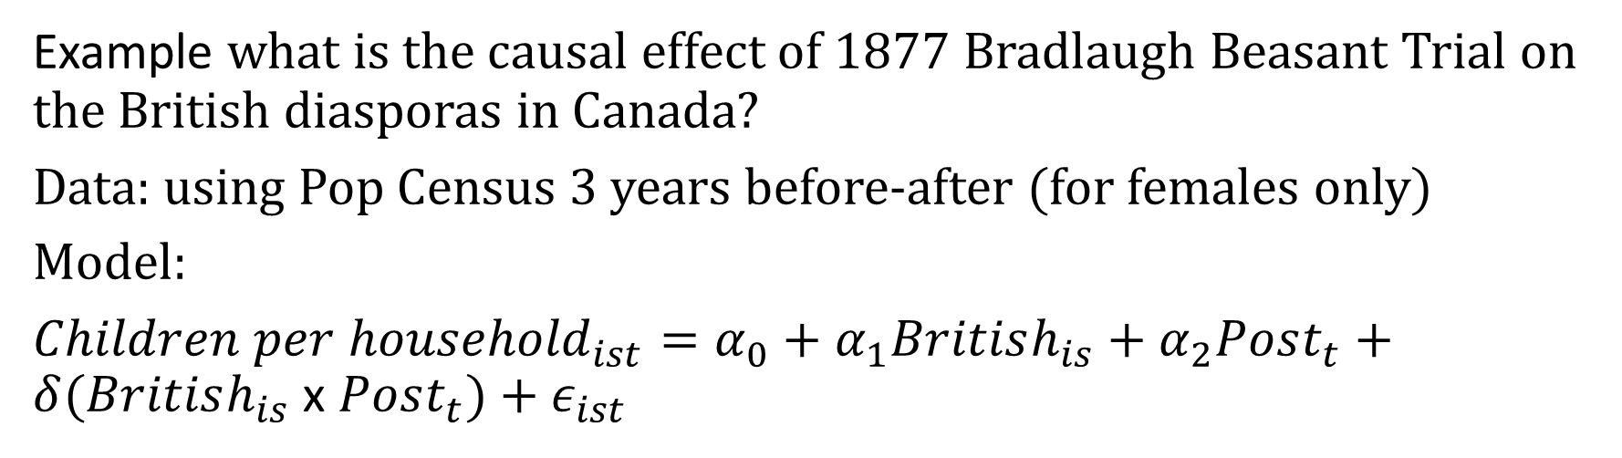
DID using Regression (OLS) Model:
Example what is the causal effect of 1877 Bradlaugh Beasant Trial on the British diasporas in Canada?
Data: using Pop Census 3 years before-after (for females only)
Model:
${Children per household}_{ist}=α_{0}+α_{1}British_{is}+α_{2}Post_{t}+δ(British_{is}$x $Post_{t})+ε_{ist}$

Slide 7
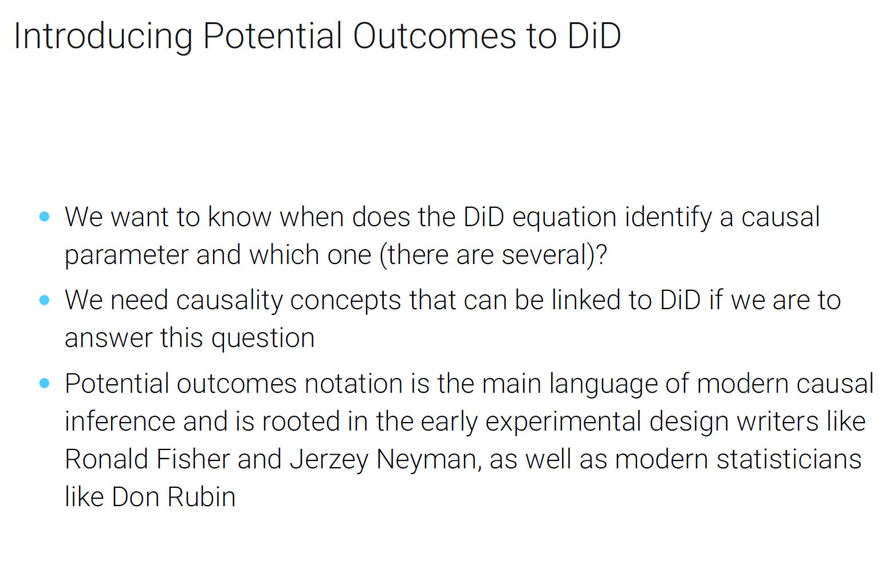

Slide 8
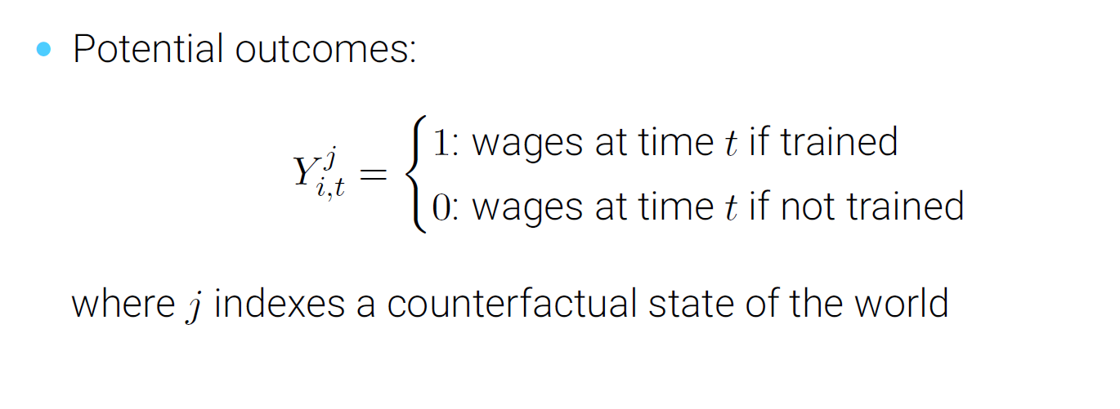
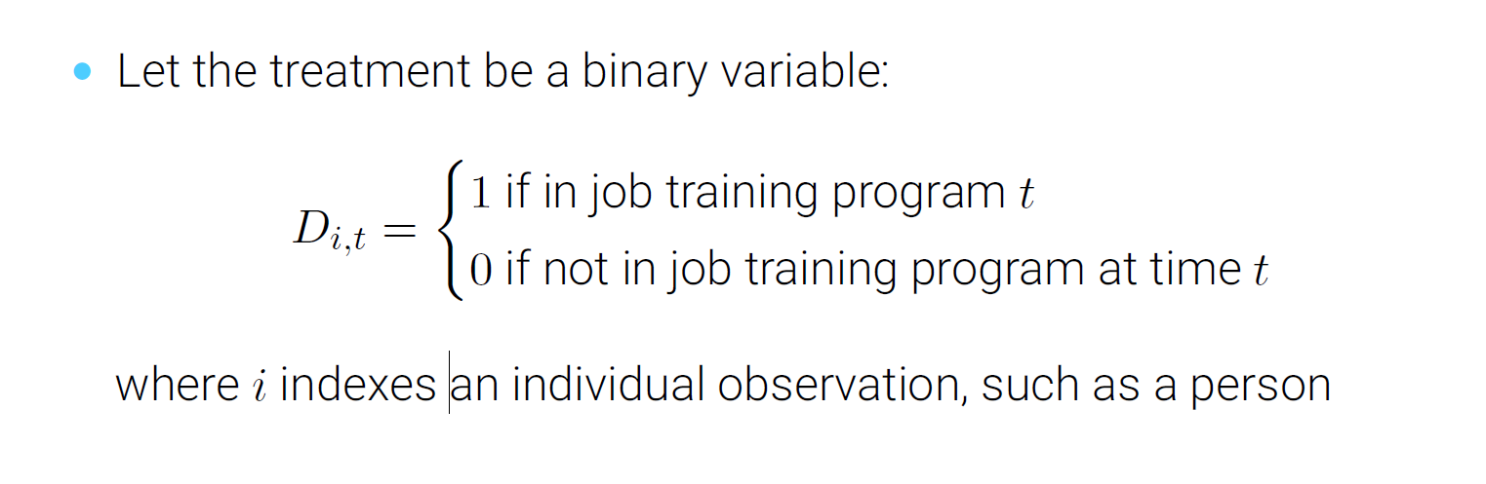

Slide 9
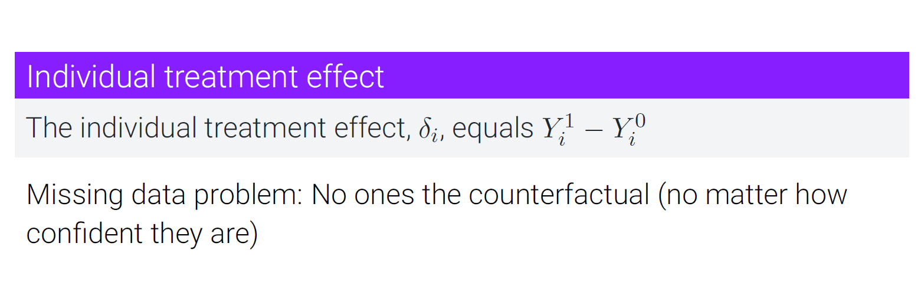
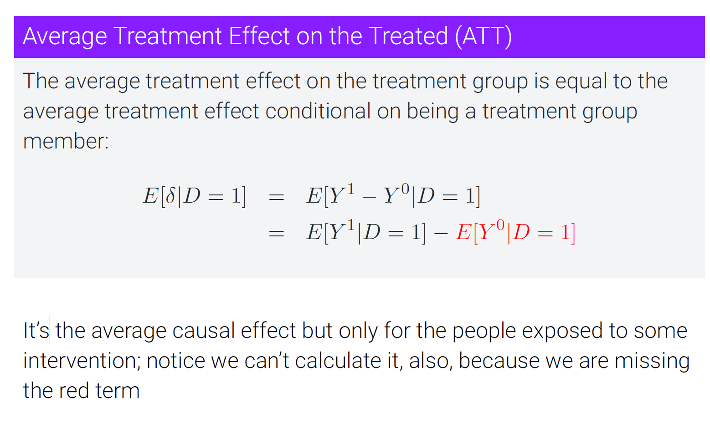

Slide 10
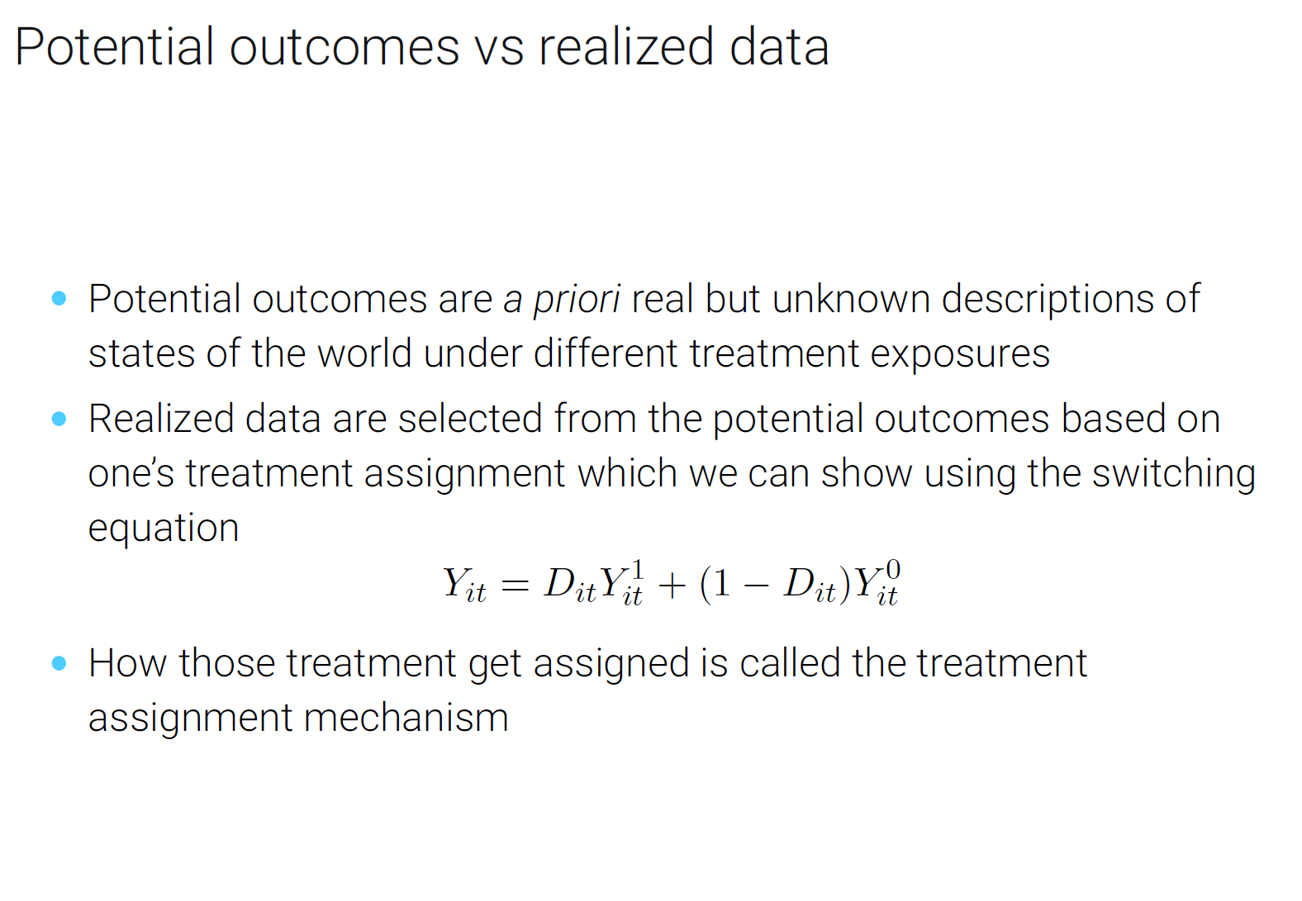

Slide 11
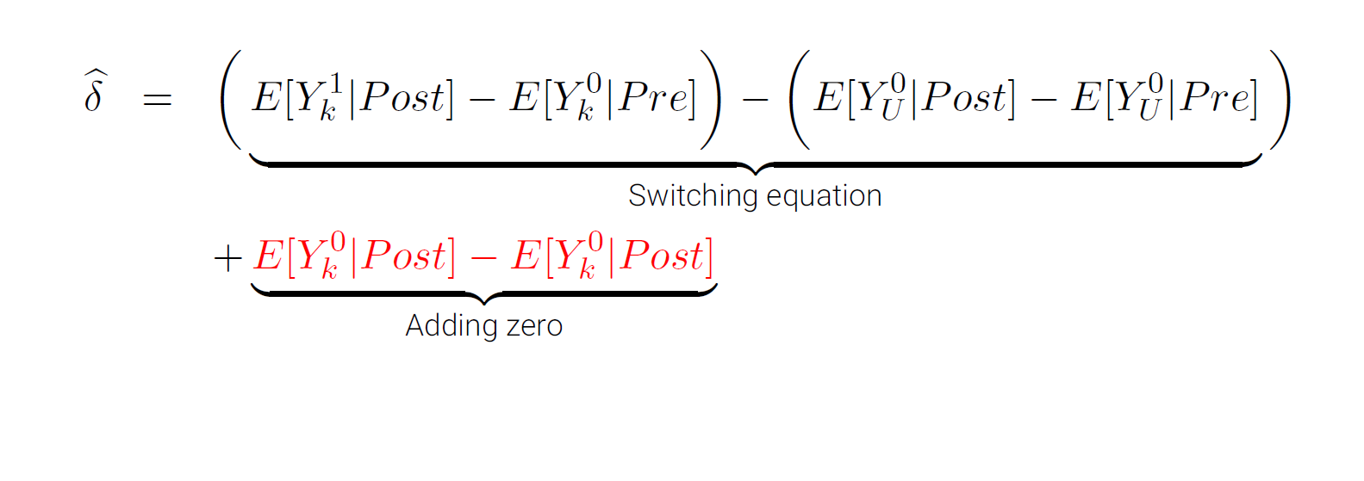
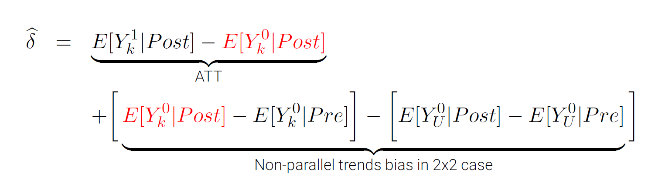

Slide 12


Slide 13
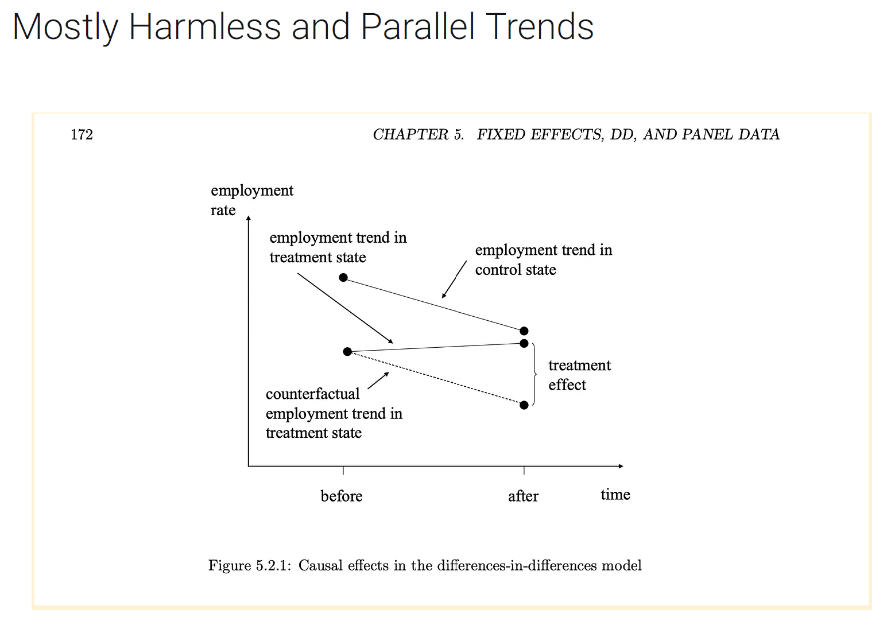
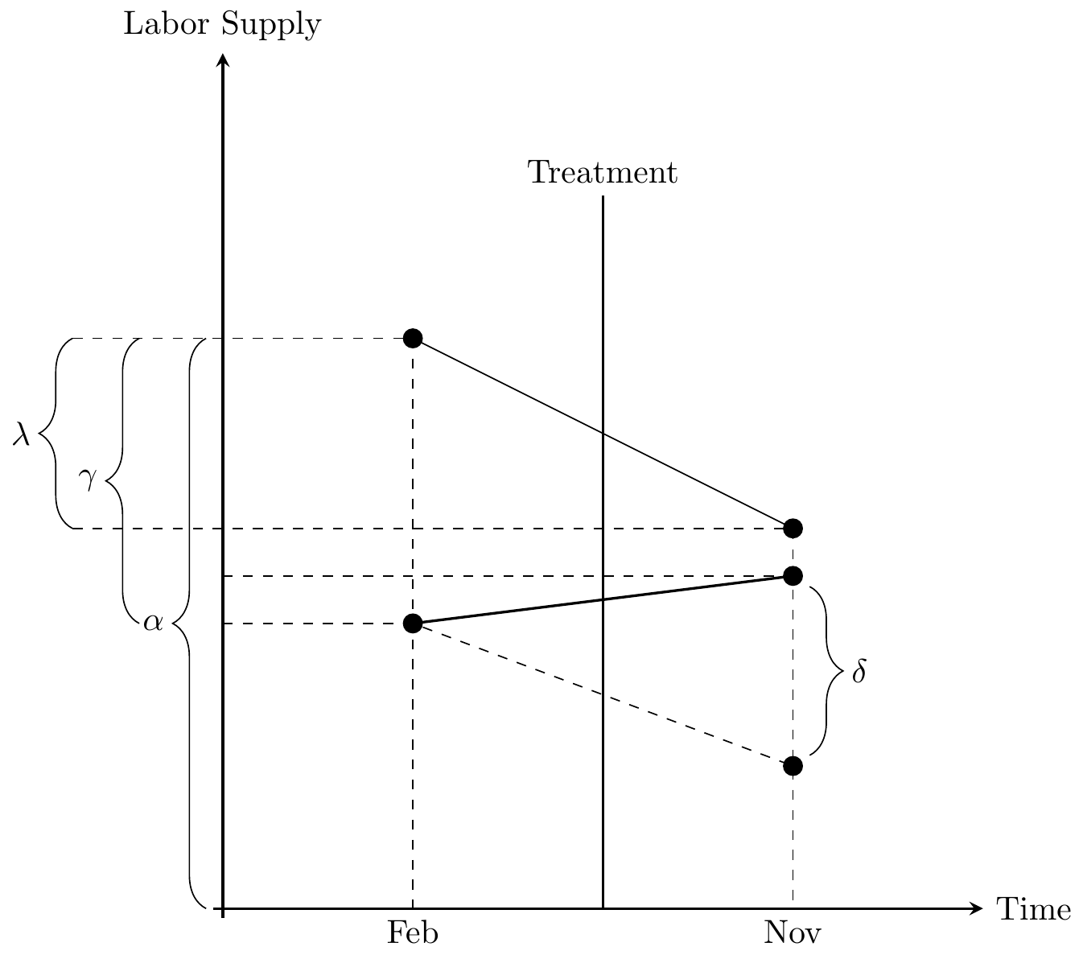
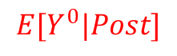
Causal effects of minimum wage passage in NJ vs Penn
Control
Treated
$$E[Y^{0}|Post]$$

Slide 14
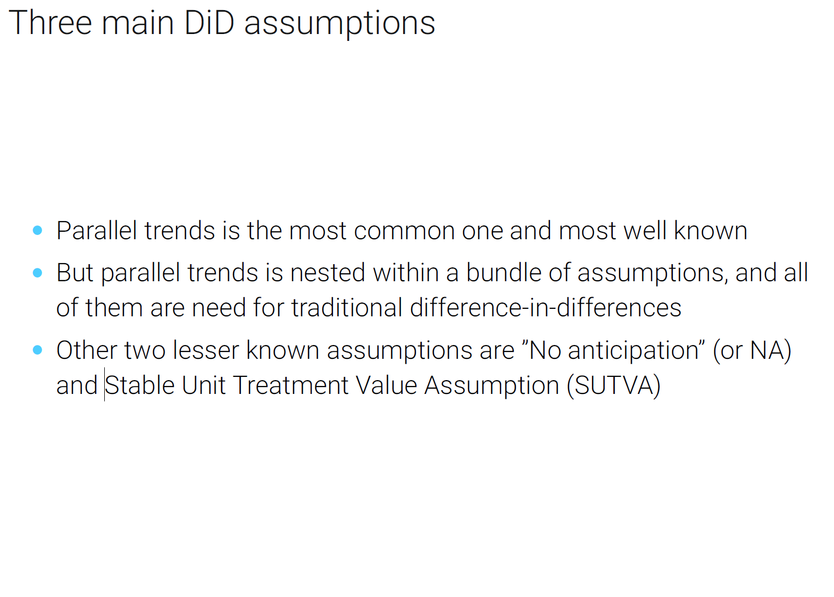

Slide 15
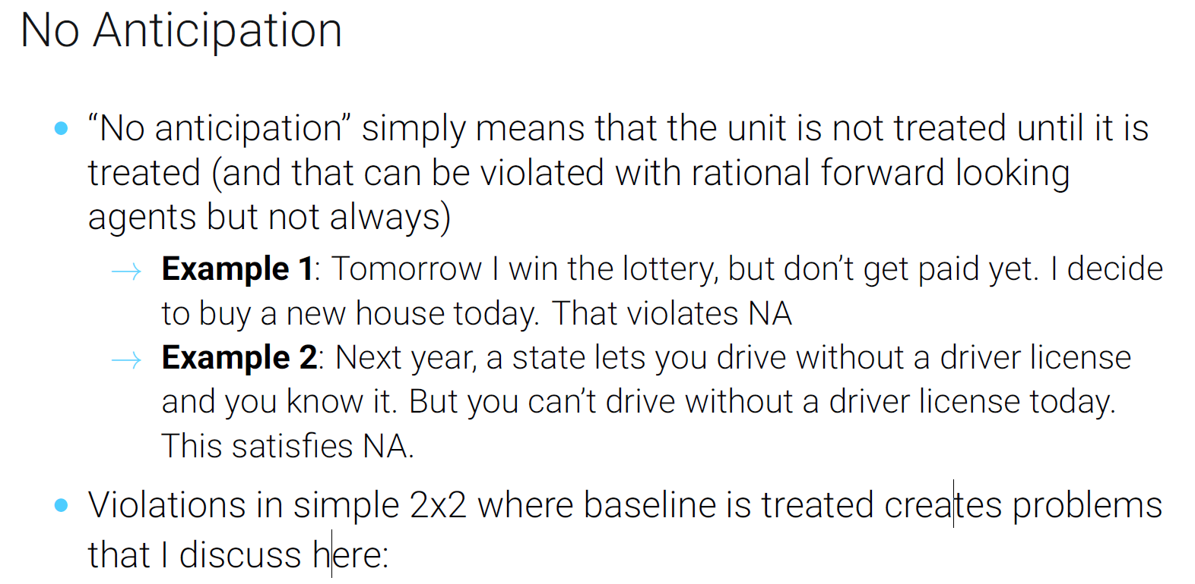

Slide 16
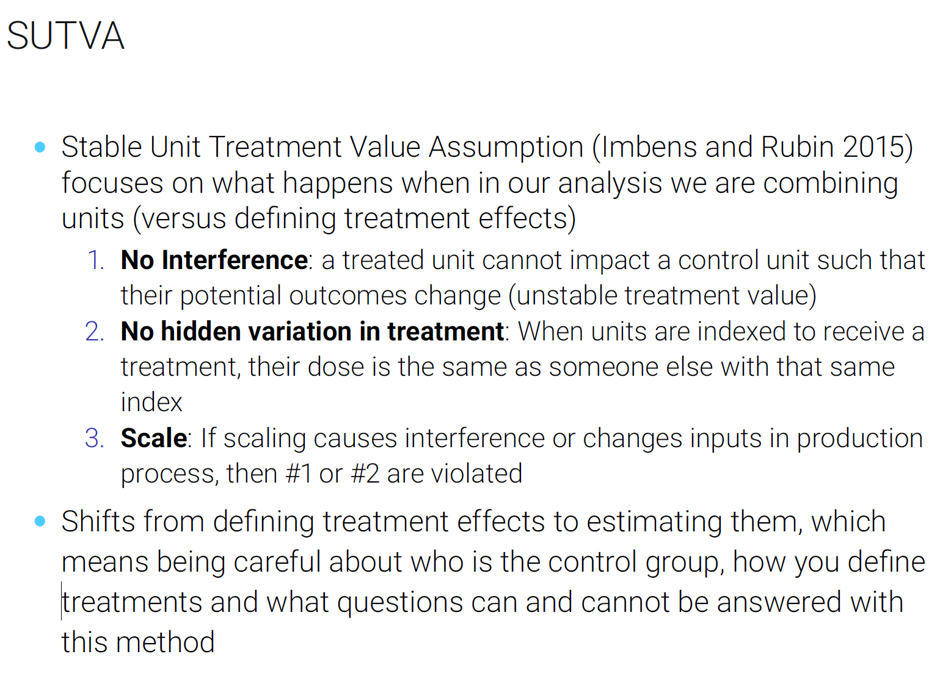

Slide 17
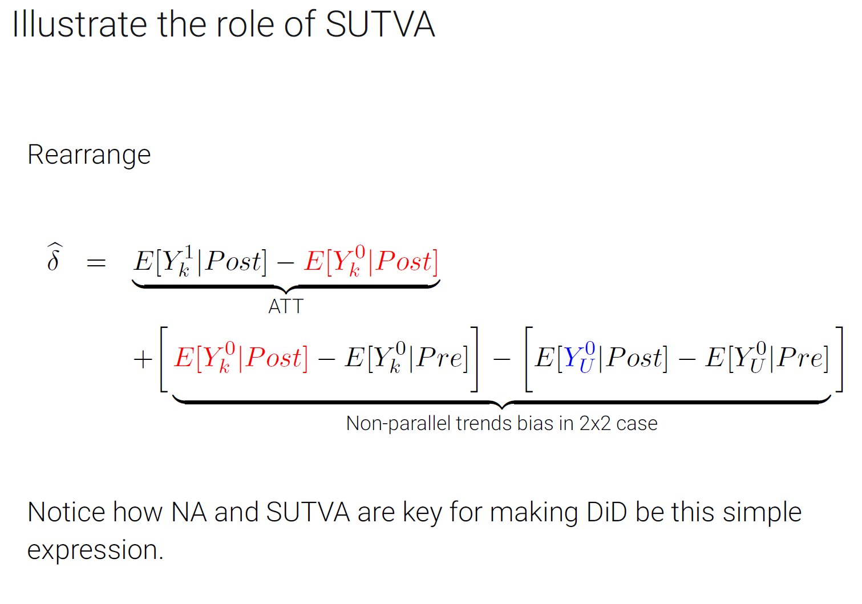

Slide 18
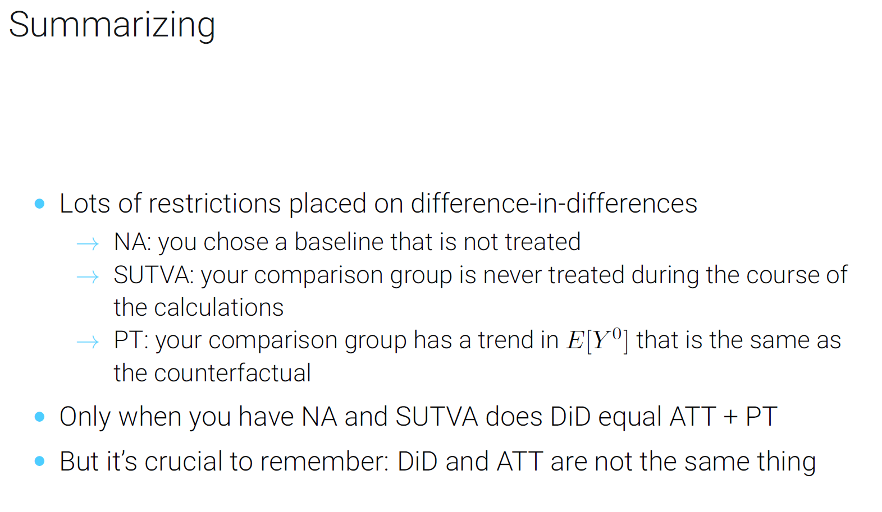

Slide 19
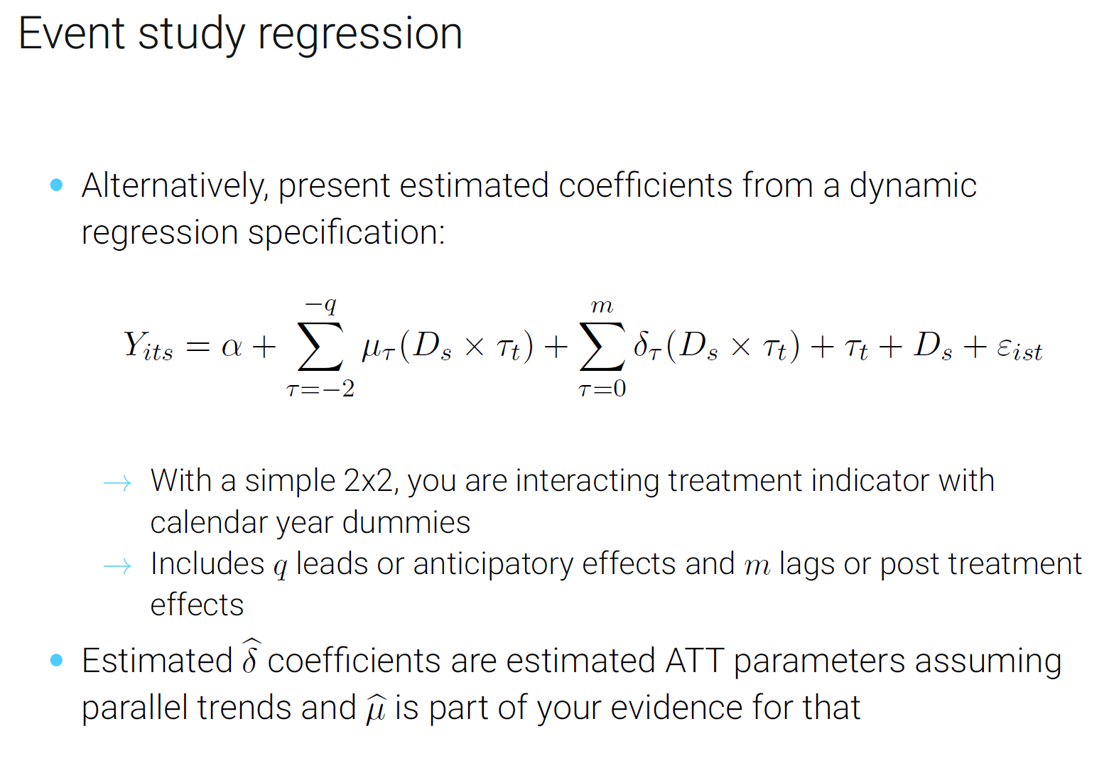

Slide 20
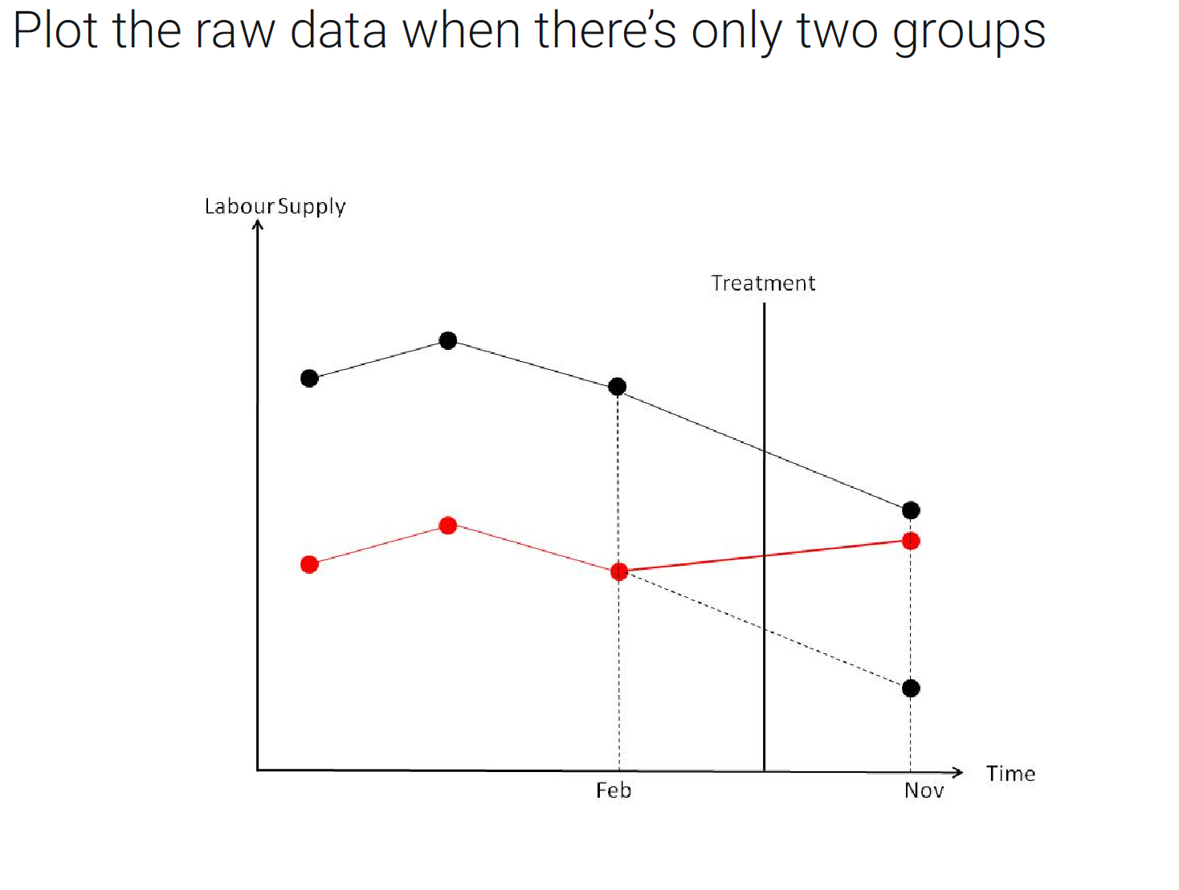
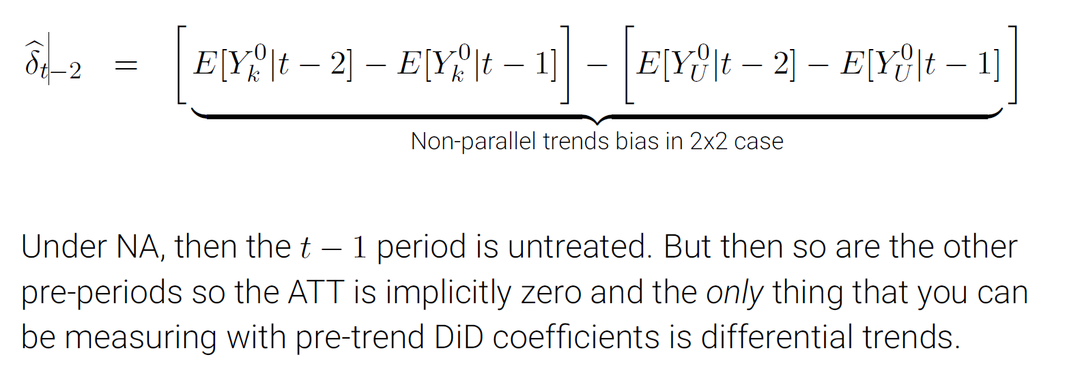
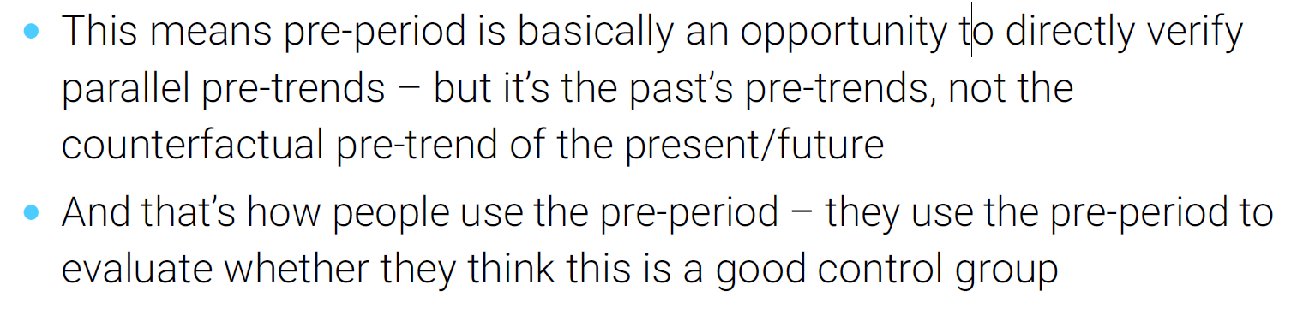

Slide 21

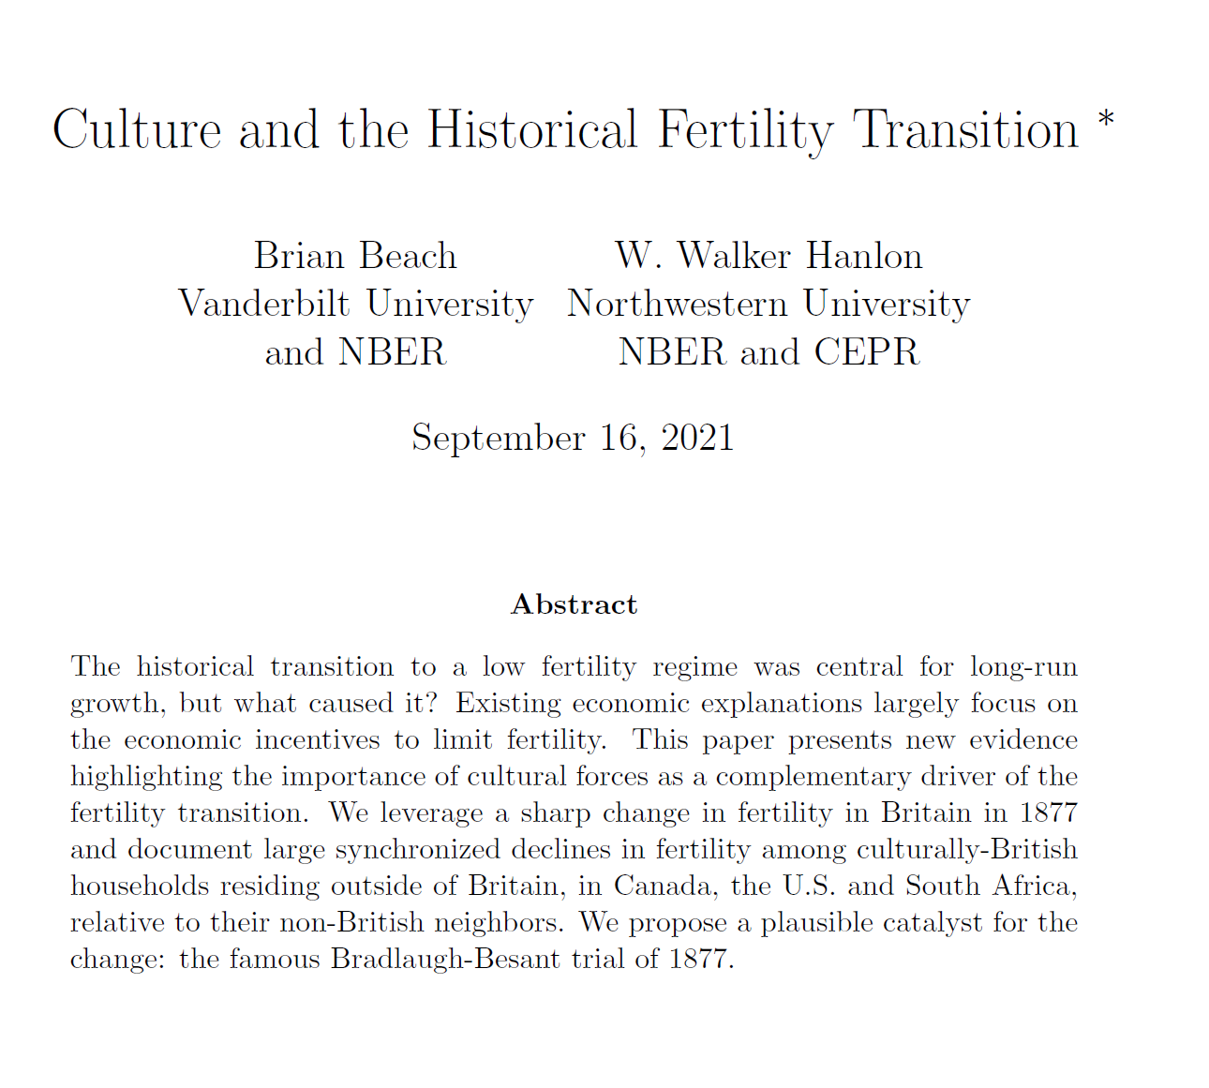
II. Paper with codes:

Slide 22
Motivation – Historic Fertility Transition
The central research question concerns of fertility transitions in industrialized society
We commonly observe high income societies have decreasing family size; but, was economic development the only cause of the birth rate decline?
What is the direct cause; other than the children quantity and quality trade-off models, or women economic empowerment?
→ Possibly, the social norms regarding acceptance toward family planning and contraception overtaking traditional family values in the England Church
→ We test this in the Bradlaugh-Beasant Trial against contraception books censorship during 1877

Slide 23
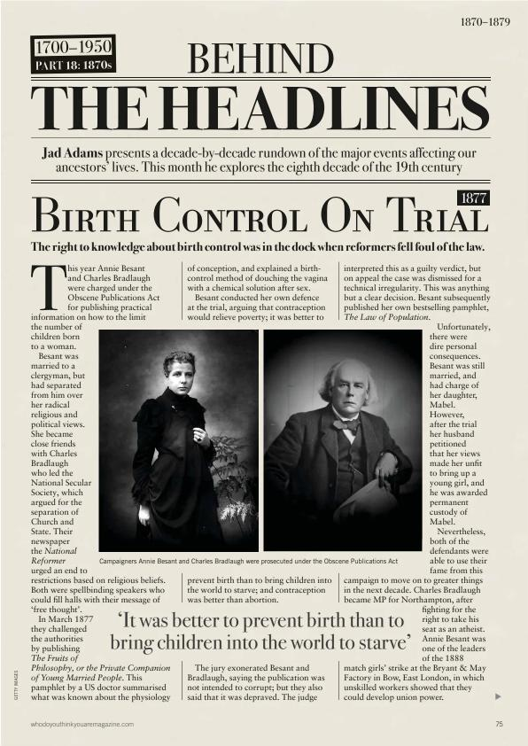
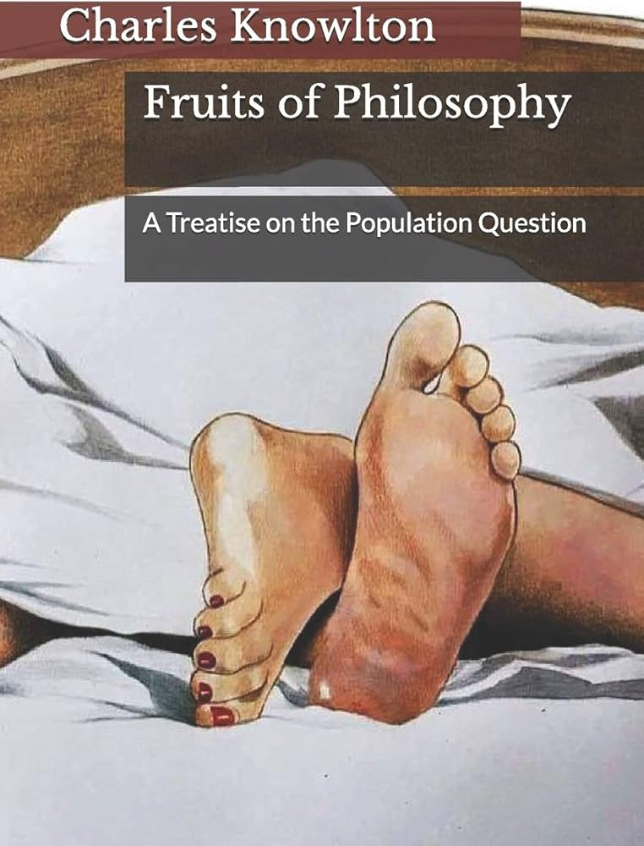
The Queen v. Charles Bradlaugh and Annie Besant
Malthusian School of Thought
“Promote
access to family planning to the poor class”

Slide 24
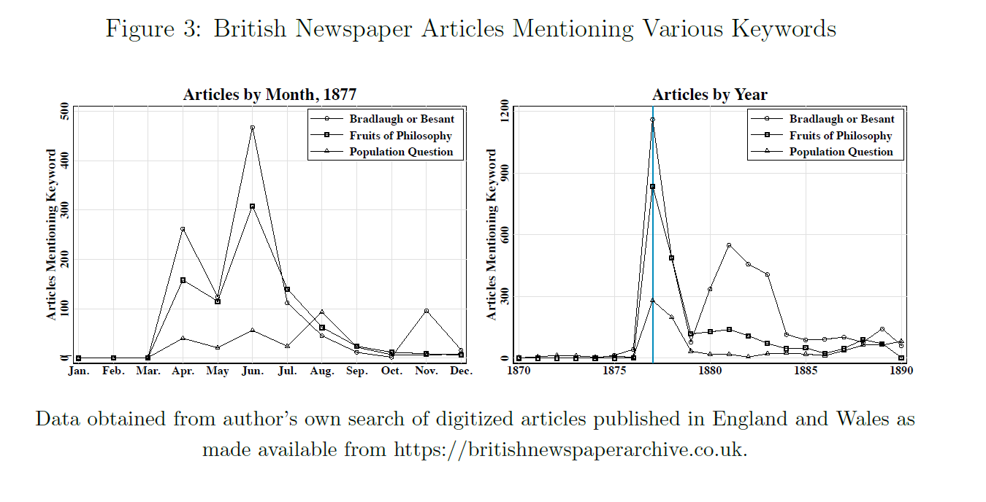
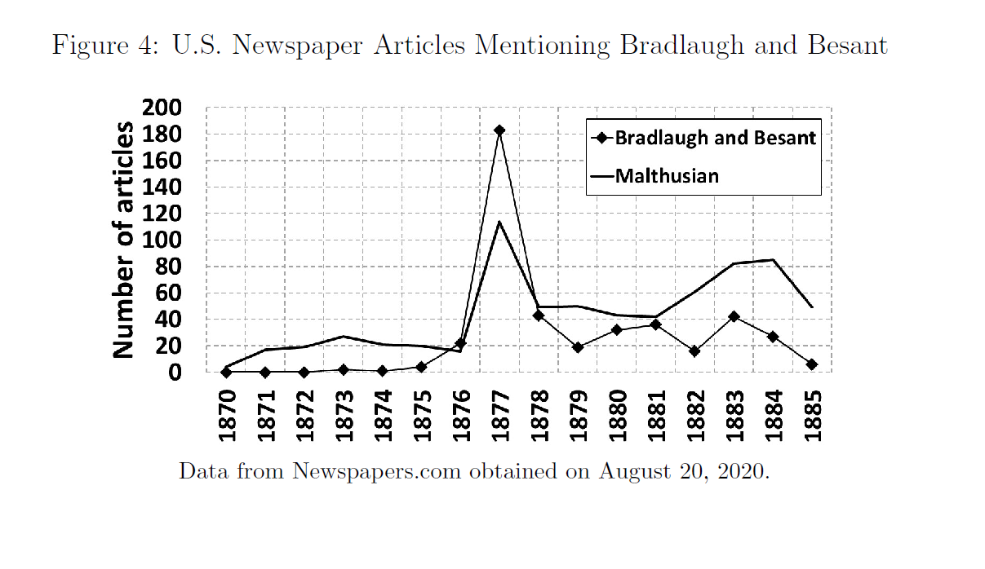
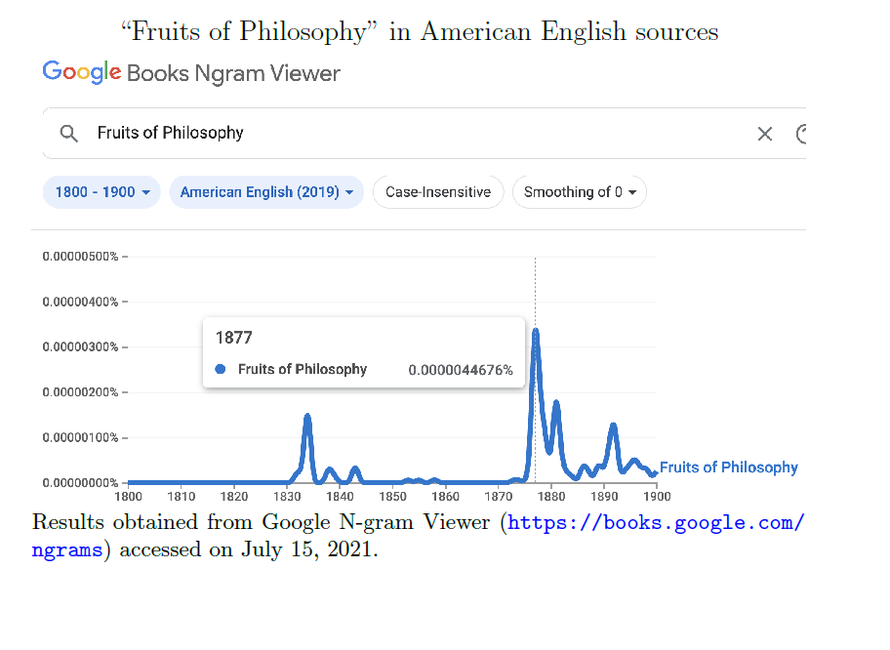

Slide 25
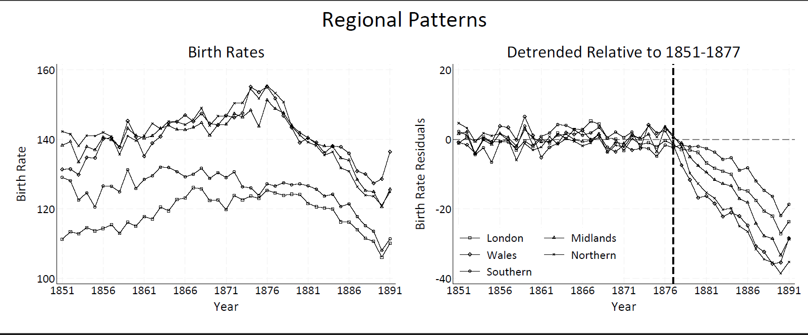
Base fact within the UK in 1877

Slide 26
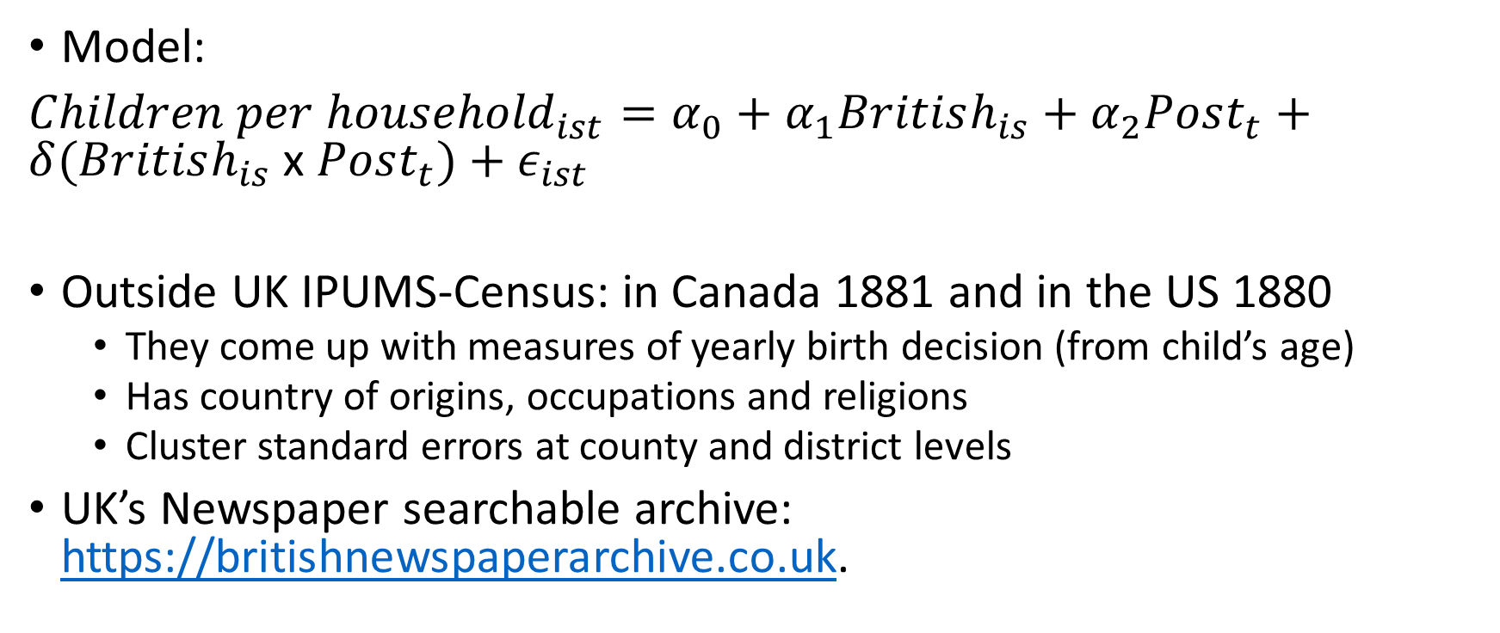
Research Design
Model:
${Children per household}_{ist}=α_{0}+α_{1}British_{is}+α_{2}Post_{t}+δ(British_{is}$x $Post_{t})+ε_{ist}$
Outside UK IPUMS-Census: in Canada 1881 and in the US 1880
They come up with measures of yearly birth decision (from child’s age)
Has country of origins, occupations and religions
Cluster standard errors at county and district levels
UK’s Newspaper searchable archive: https://britishnewspaperarchive.co.uk.

Slide 27
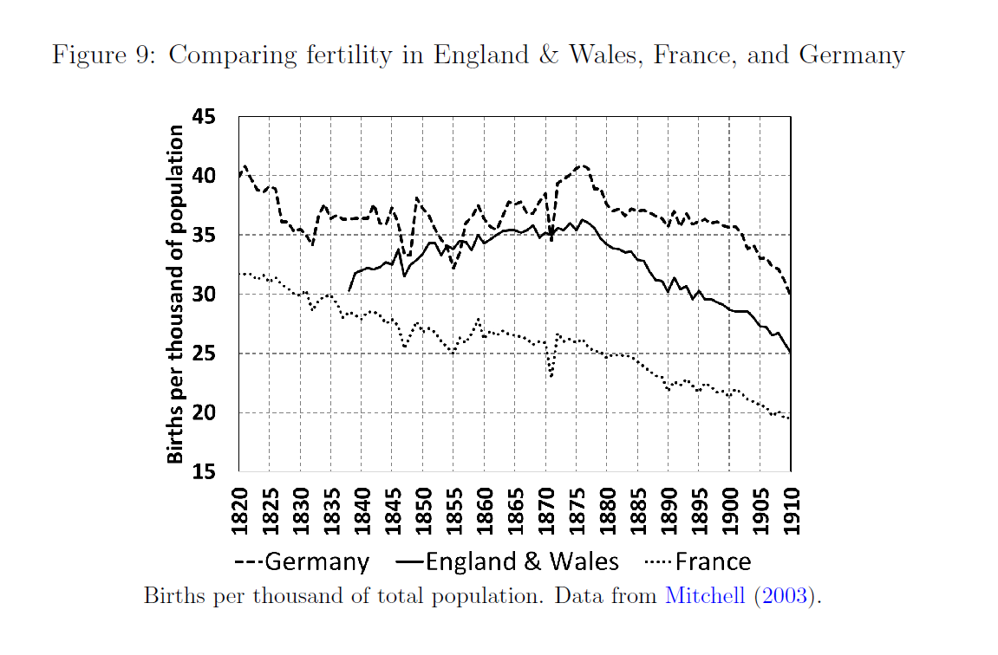

Slide 28
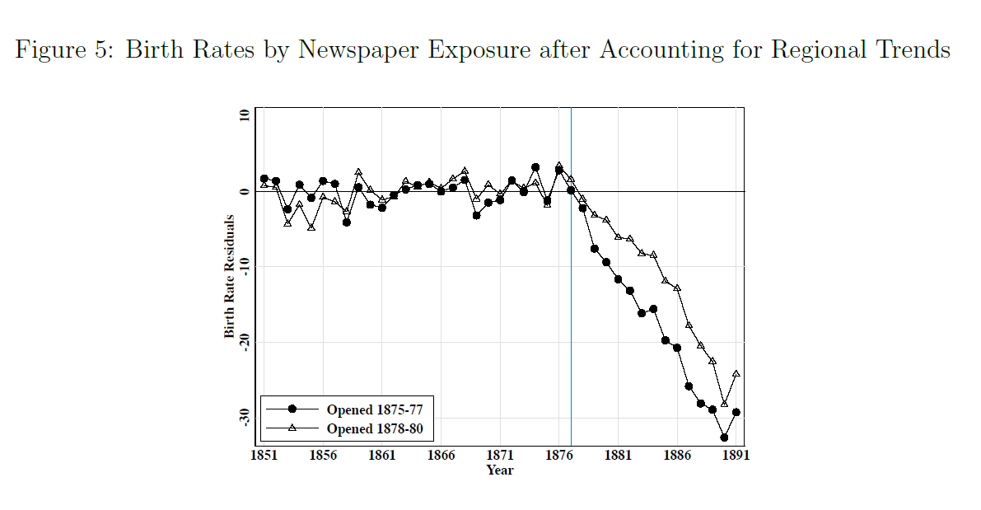
UK Newspapers opening date helps define long v. short exposure-to-trial groups

Slide 29
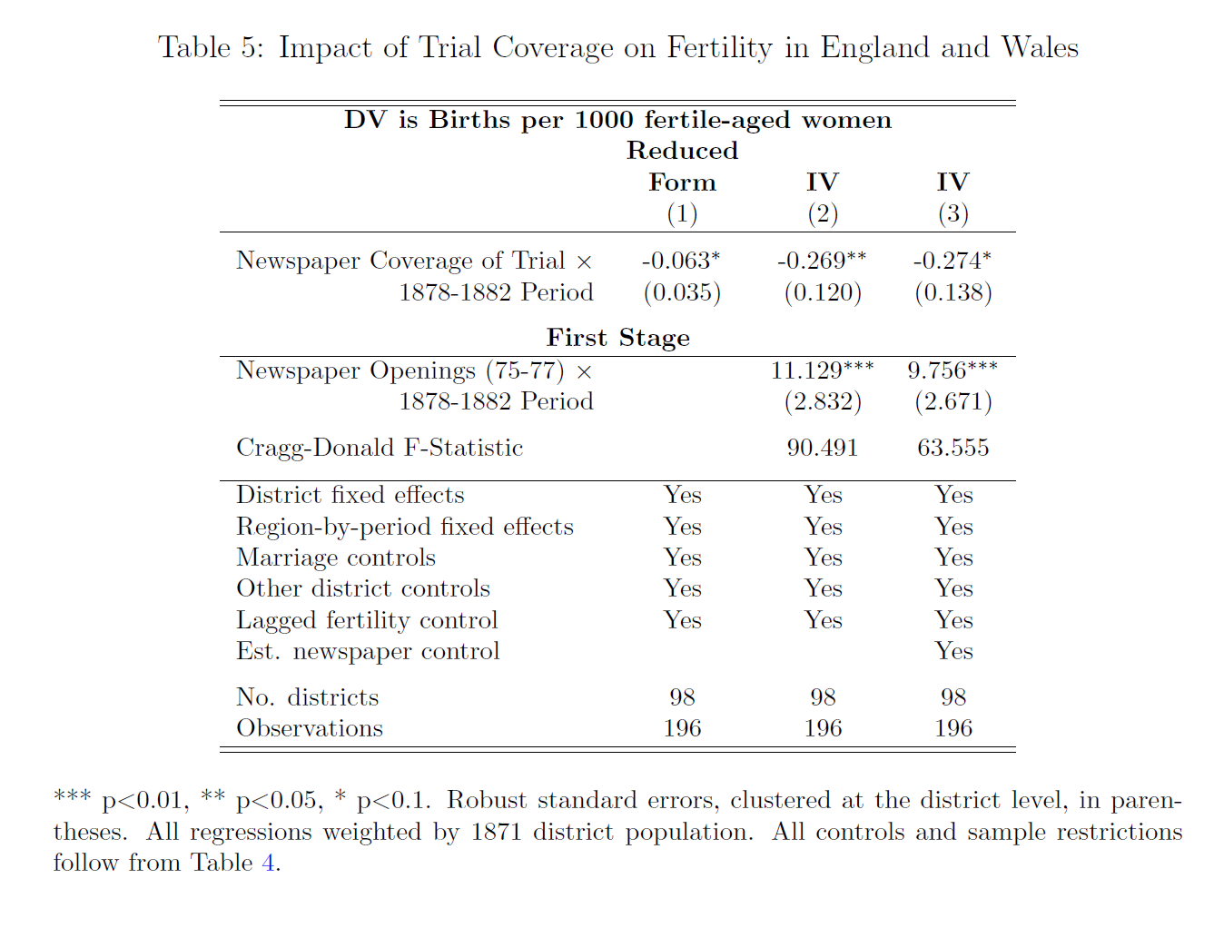

Slide 30
Conclusion

